Slide 1

Client: Emily Aldrich Barbour
Notes:
Natalie
• Provide an overview of your plan: include a synopsis of your problem/opportunity, consider including a truncated SWOT analysis.
• Spend time focusing on what you set out to do in your plan.
• What is your objective?
• What are your key strategies and tactics?
• SHOW your work — screenshots, templates, etc.
• What’s next? What do you recommend the client do in the near - to - mid-term to capitalize on your work?
• Any “big ideas” you want to highlight? Are there things that you wish you had time or budget for that your client should consider going forward?

Slide 2
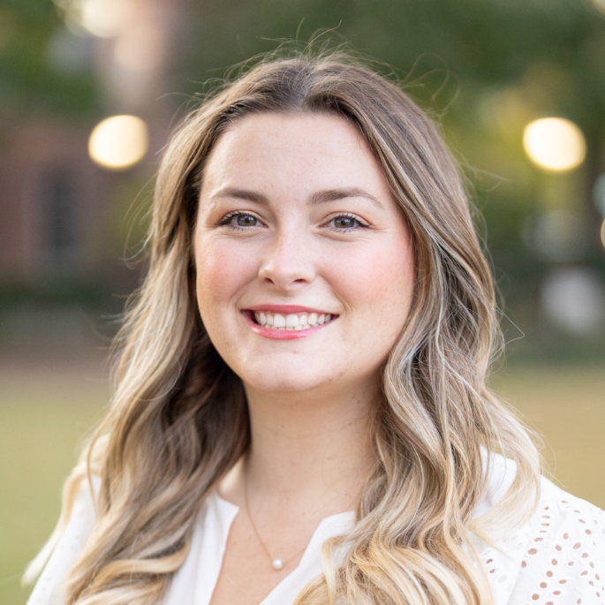
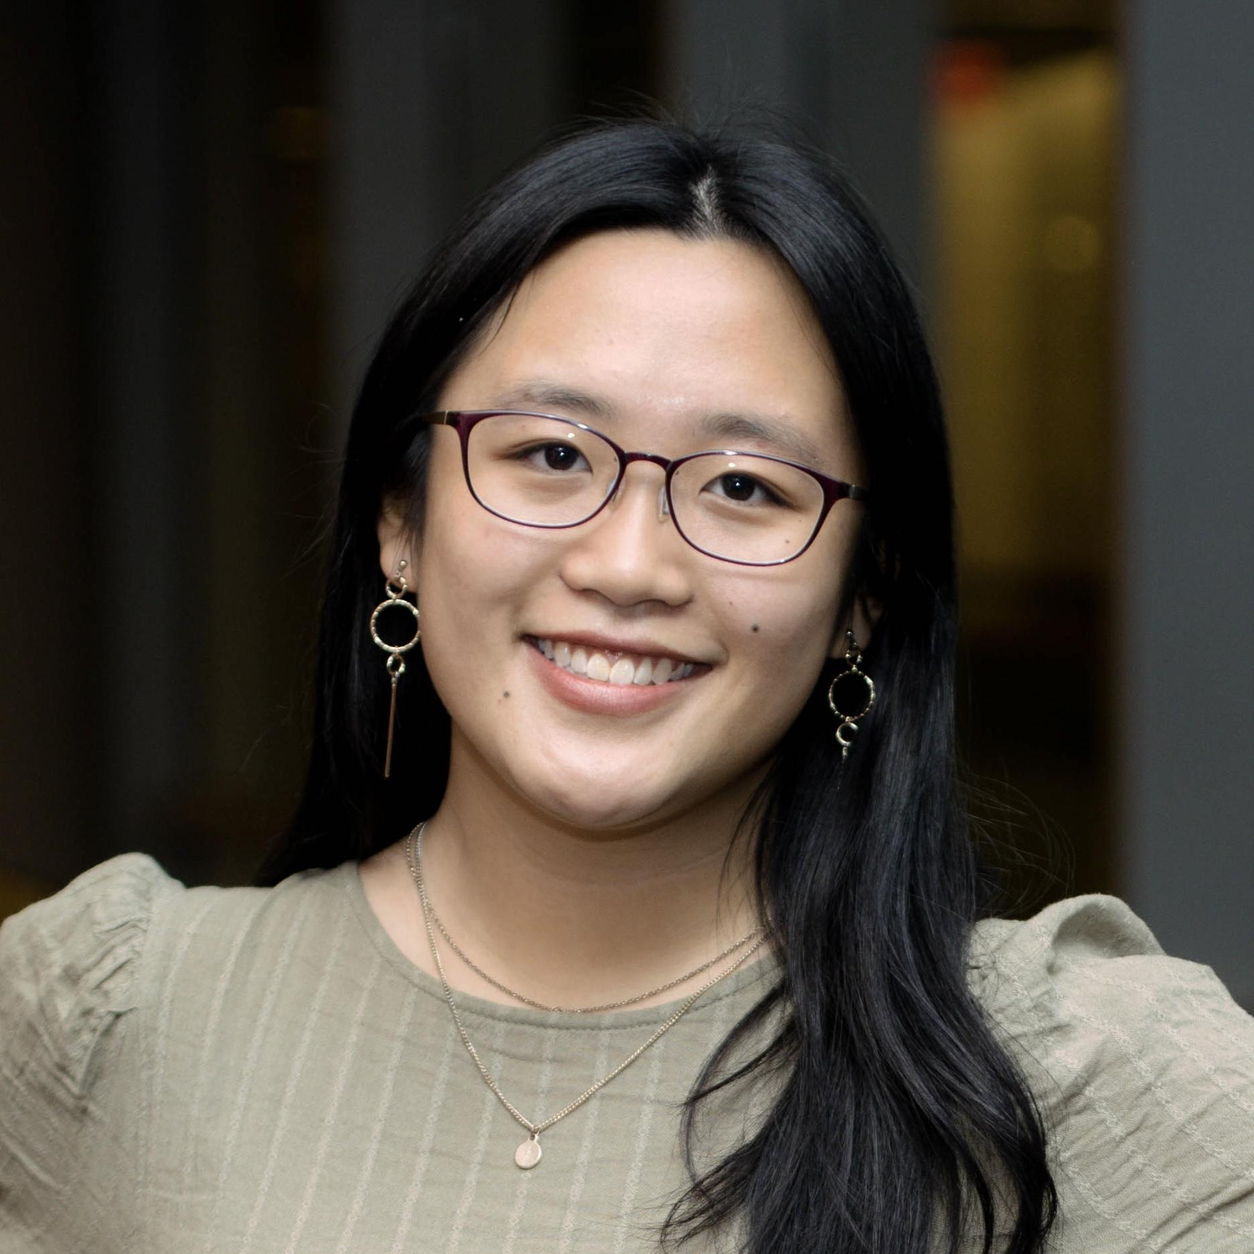
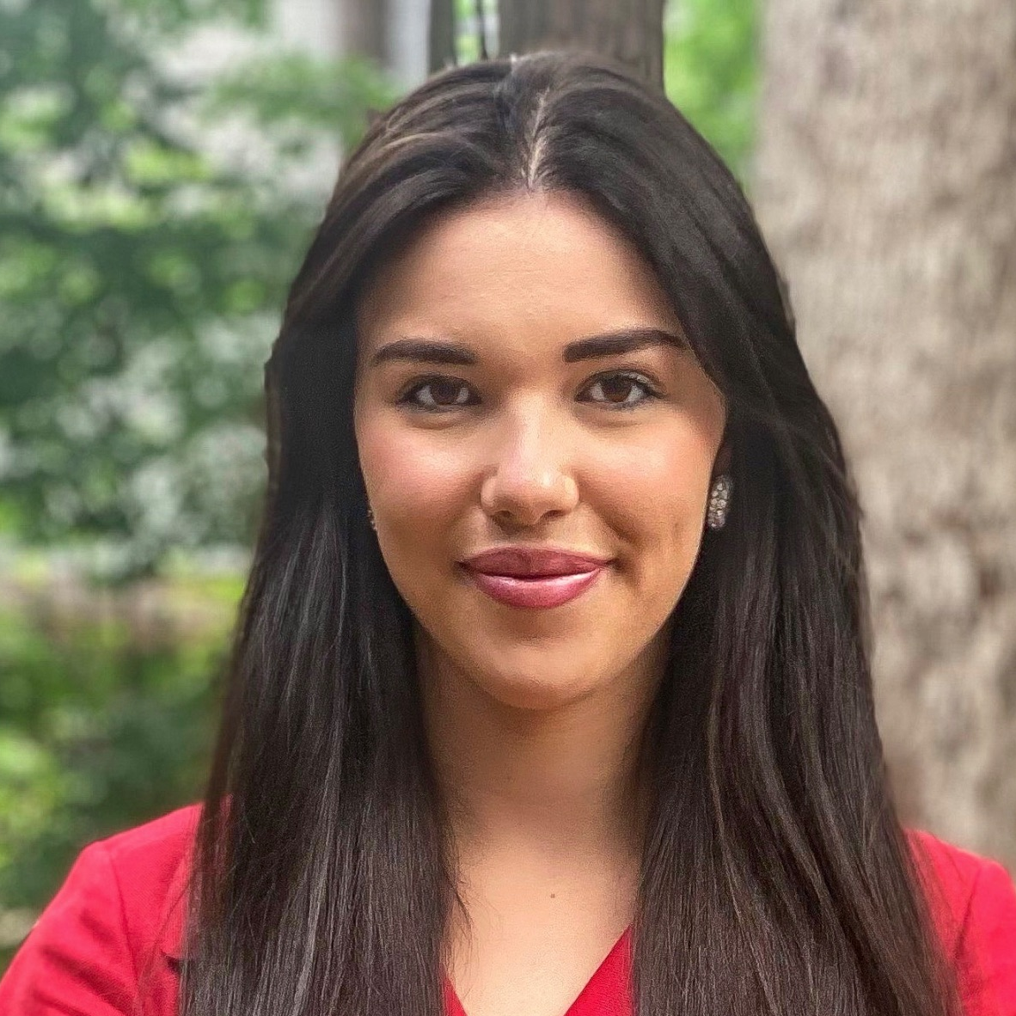
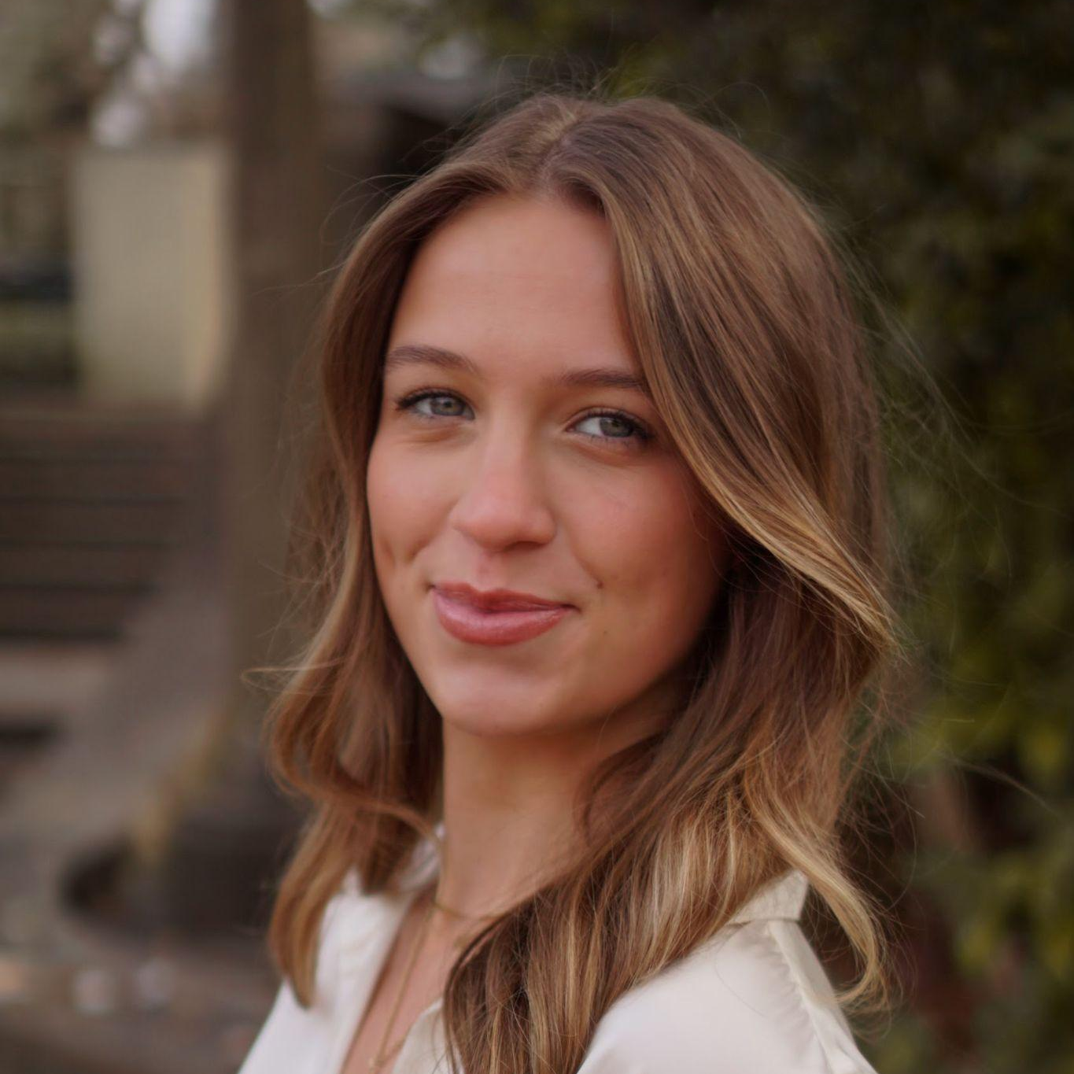
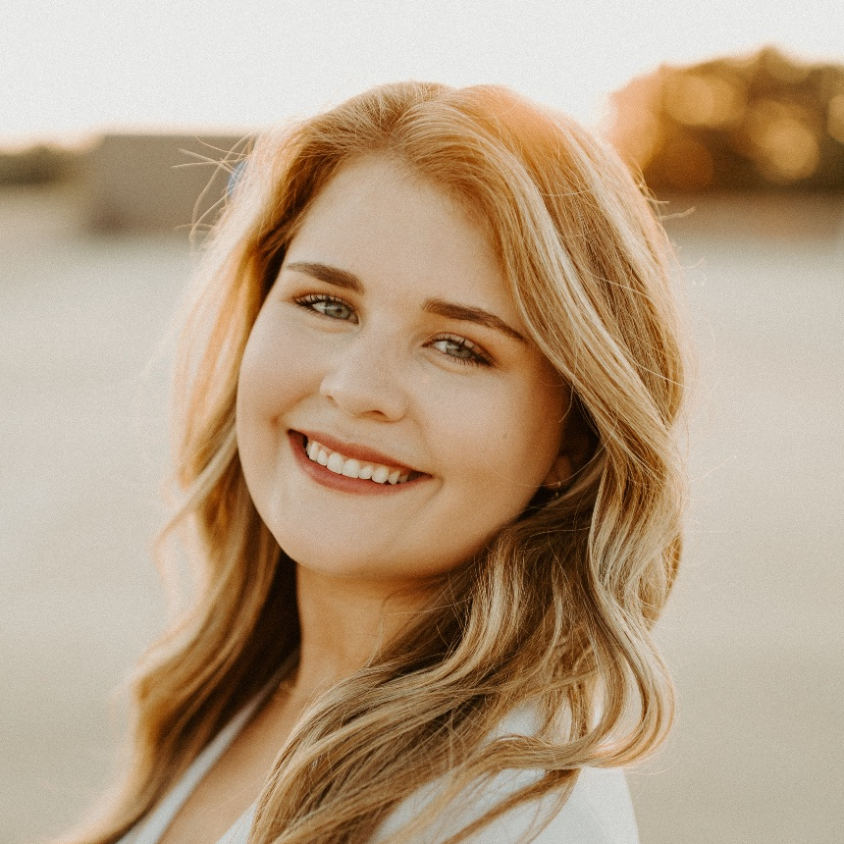
MEET THE TEAM
Ayden
Law
Visual Lead & Designer
Natalie
Yeung
Project Team Manager
Hailey
Hawkins
Team Communication Lead
Meah Osborne
Editor
Taylor Randolph
Client Communication Lead
COM 476 FALL 2023
Notes:
Natalie

Slide 3
SWOT Grid
Strengths: Part of an international parent company. Brand association. Great current housing market. We are not in an election year. Agents age and wisdom. Agents ability to relationship build. | Weaknesses: Limitations set by Sotheby’s International Realty brand. The brand appears geared towards the wealthy. Agent’s social media presence. Agent’s online presence. Limited client base (primarily 50-75 years old). Agent is behind on industry trends. Agent is lacking a personal team.
Opportunities: People and businesses moving into Raleigh. Tabling and booths at community events. Real estate awards. Posting on the Next Door app. Hiring a social media intern/assistant. Informational and educational social media content. | Threats: Political trends and administration in NC (Election Year influences homebuyer decisions) Top realtor competitors -niche players intensive field Clients are aging out of the home buying stage. Shifting population and buyer demographics. Market shifts in the Triangle (spiked interest rates). Lack of interest in new technology.

Slide 4
Campaign Objective & Strategies
OBJECTIVE
  Within the next 12 months, enhance Emily Aldrich Barbour’s online presence by achieving a 30% increase in her social media followers from Millennial and Gen-Z client bases.
STRATEGIES
  Strengthen Emily’s ability to attract Millennial and Gen-Z clients by increasing her understanding of the target publics’ behaviors and attitudes.
  Establish Emily as the go-to-agent in the Triangle Area by improving her online presence and social media visibility to her target audience.
Notes:
Natalie

Slide 5
Campaign Tactics
TACTICS
  Create and distribute a Google Form survey to gather research and data on Millennial and Gen-Z publics.
  Write Instagram captions for her “Emily in Raleigh” series to show off her expertise and direct followers to use her services.
  Develop a content calendar for Instagram and Facebook to set a regular and consistent posting schedule.
  Establish tips and guidelines to help Emily transition her Instagram and Facebook social media accounts to better represent her professional persona.
Notes:
Natalie

Slide 6
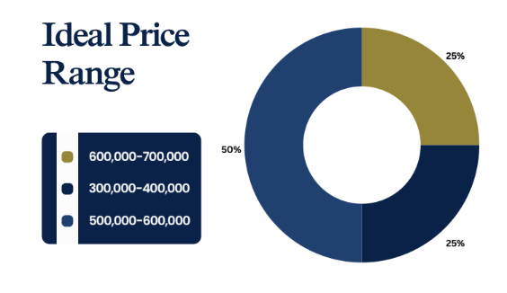
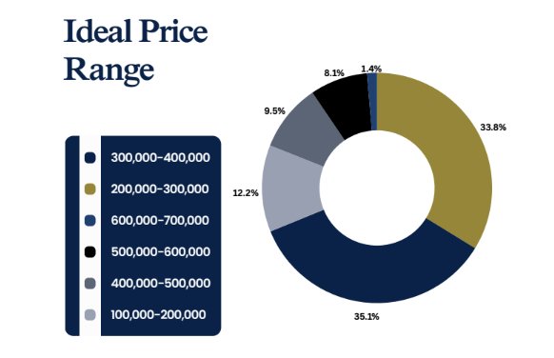
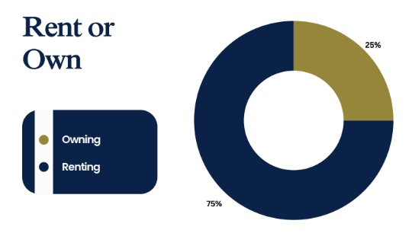
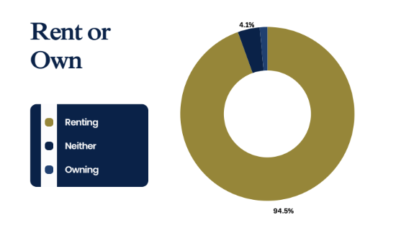
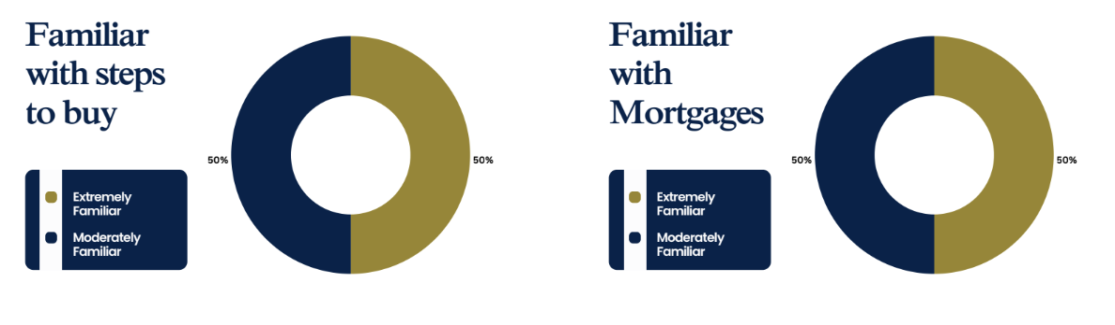
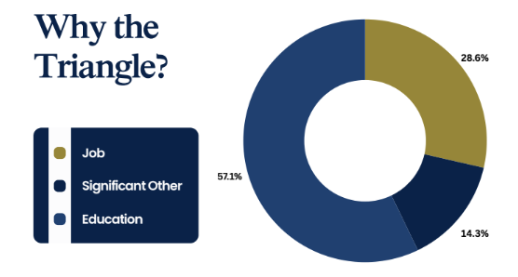
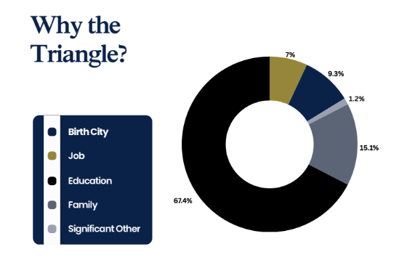
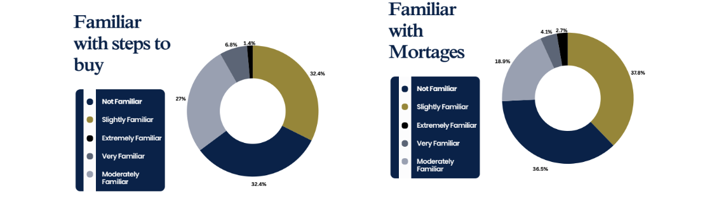
Campaign Objective, Strategies, Tactics
Millennials
Gen Z
Millennials
Gen Z
Notes:
Meah

Slide 7
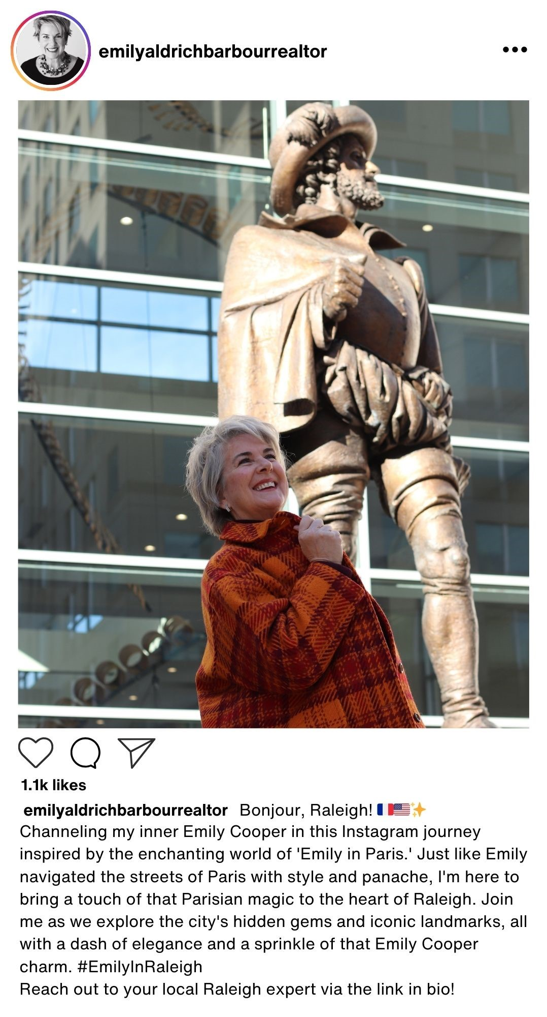
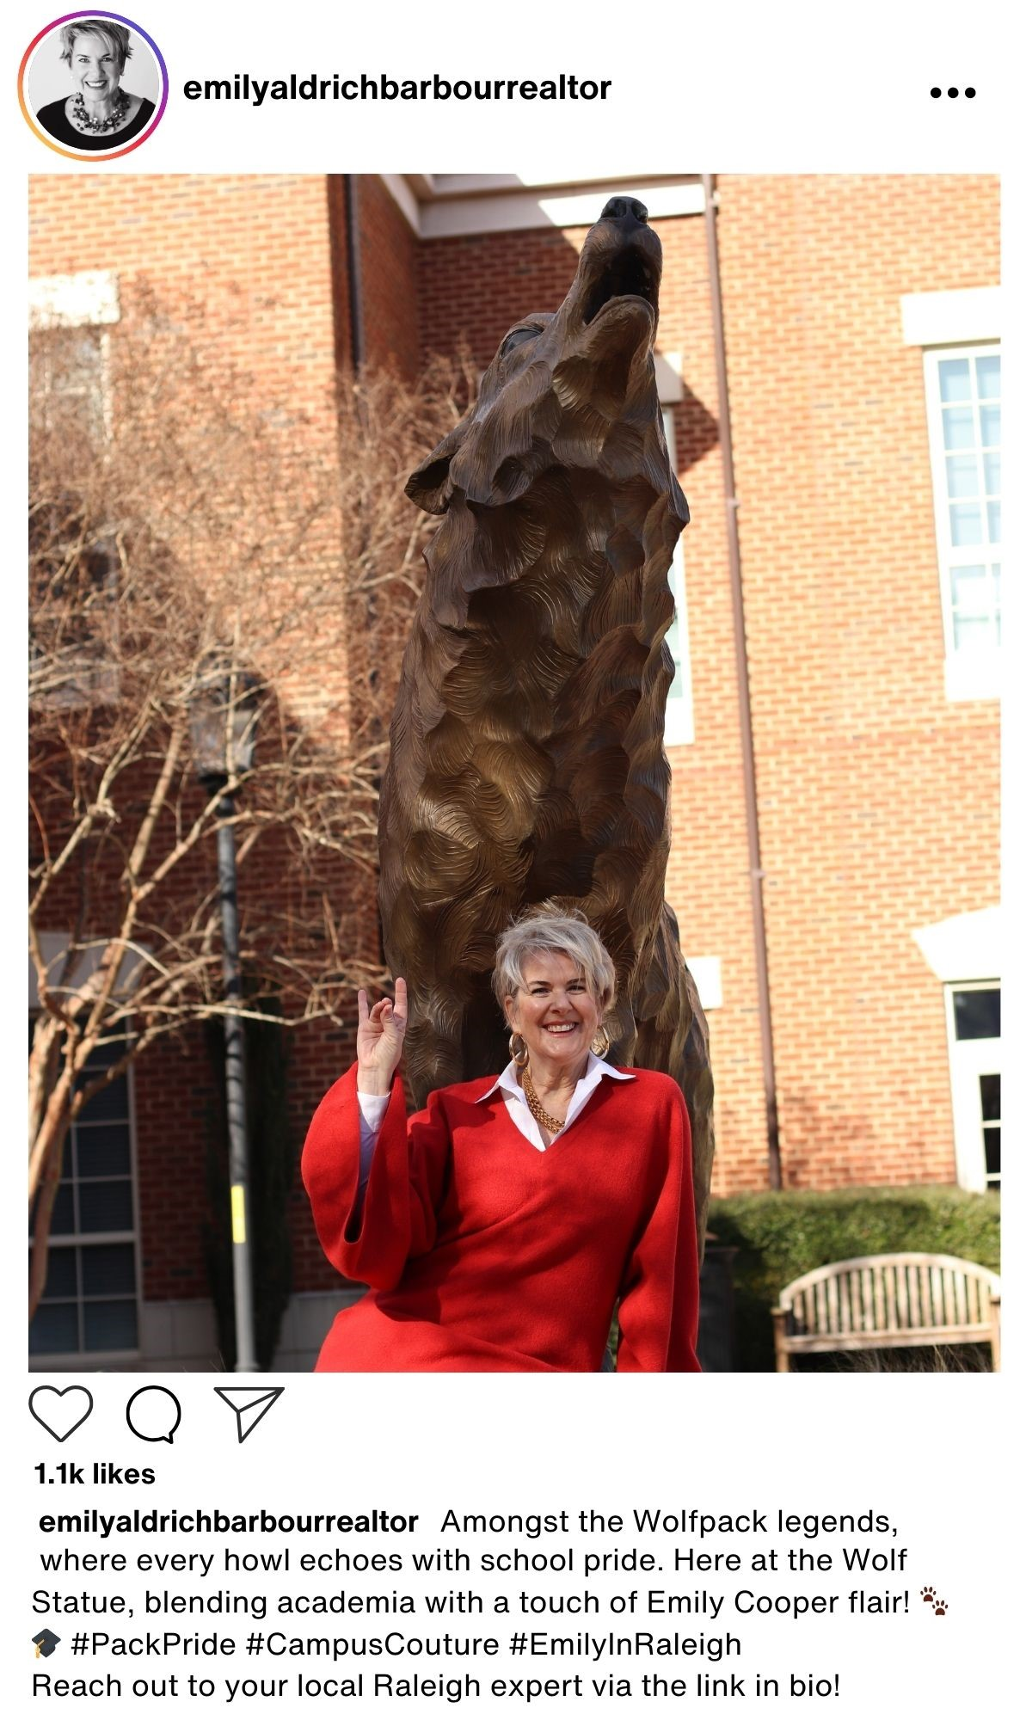
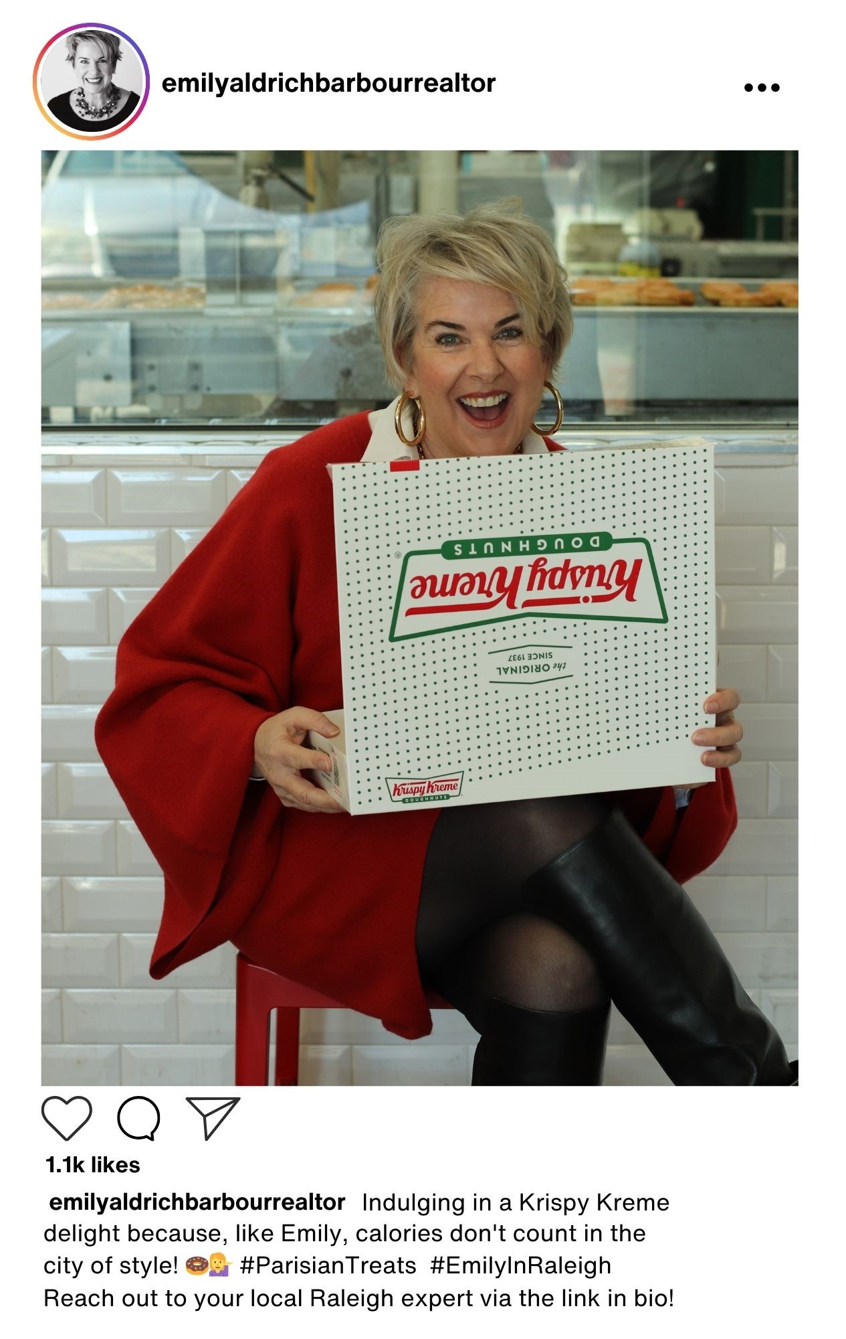
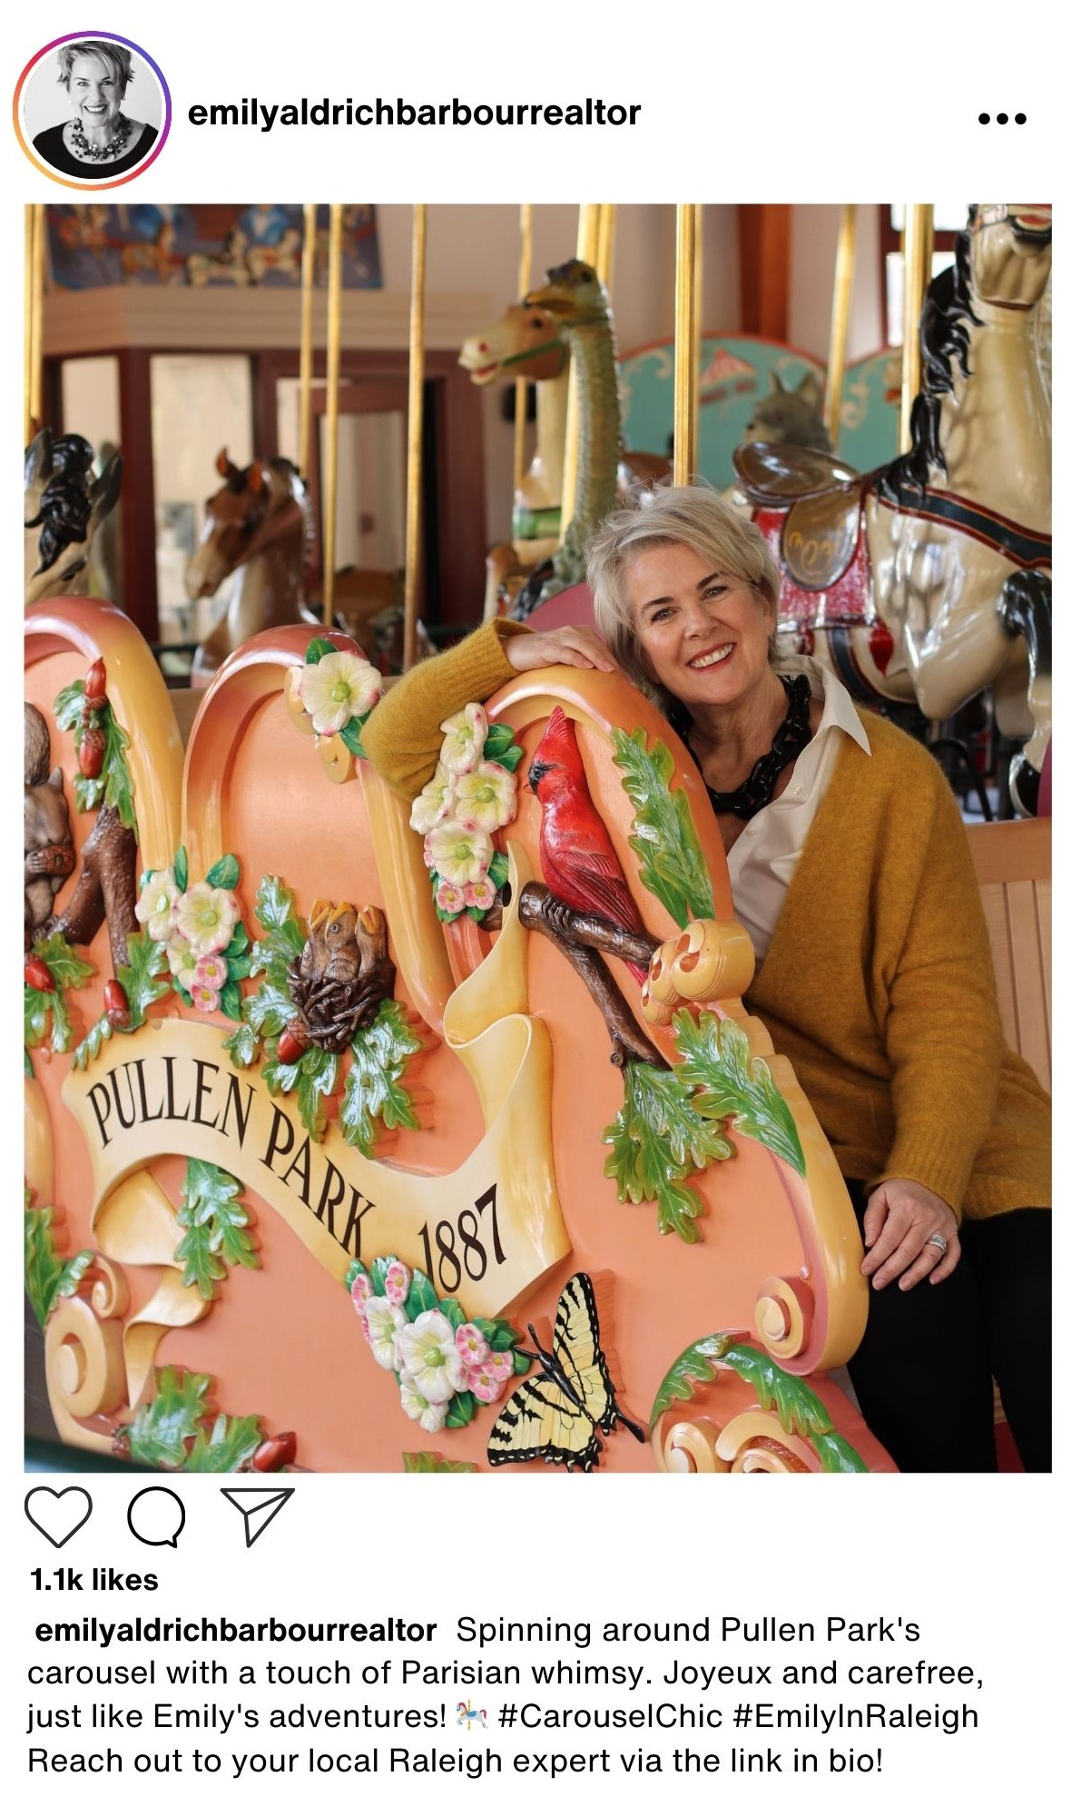
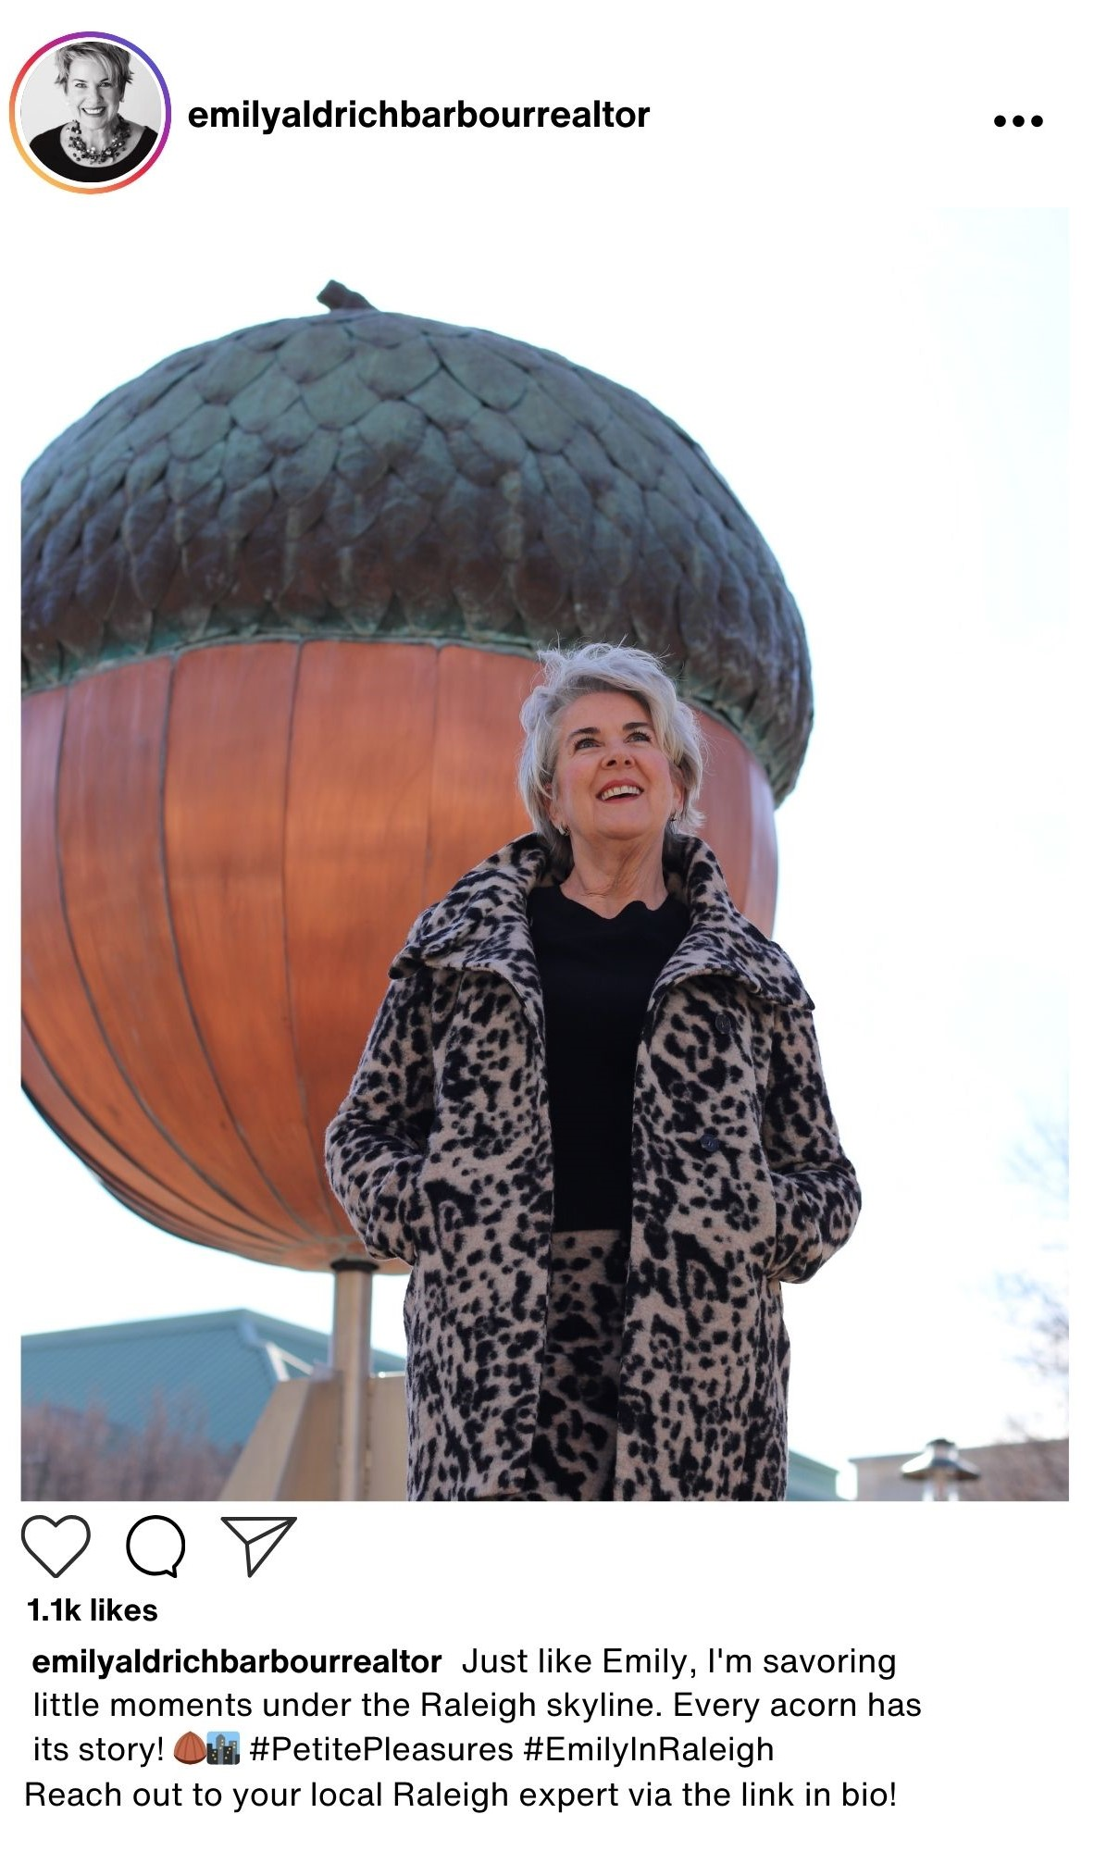
Emily in Raleigh Instagram Post Examples
Notes:
Taylor

Slide 8
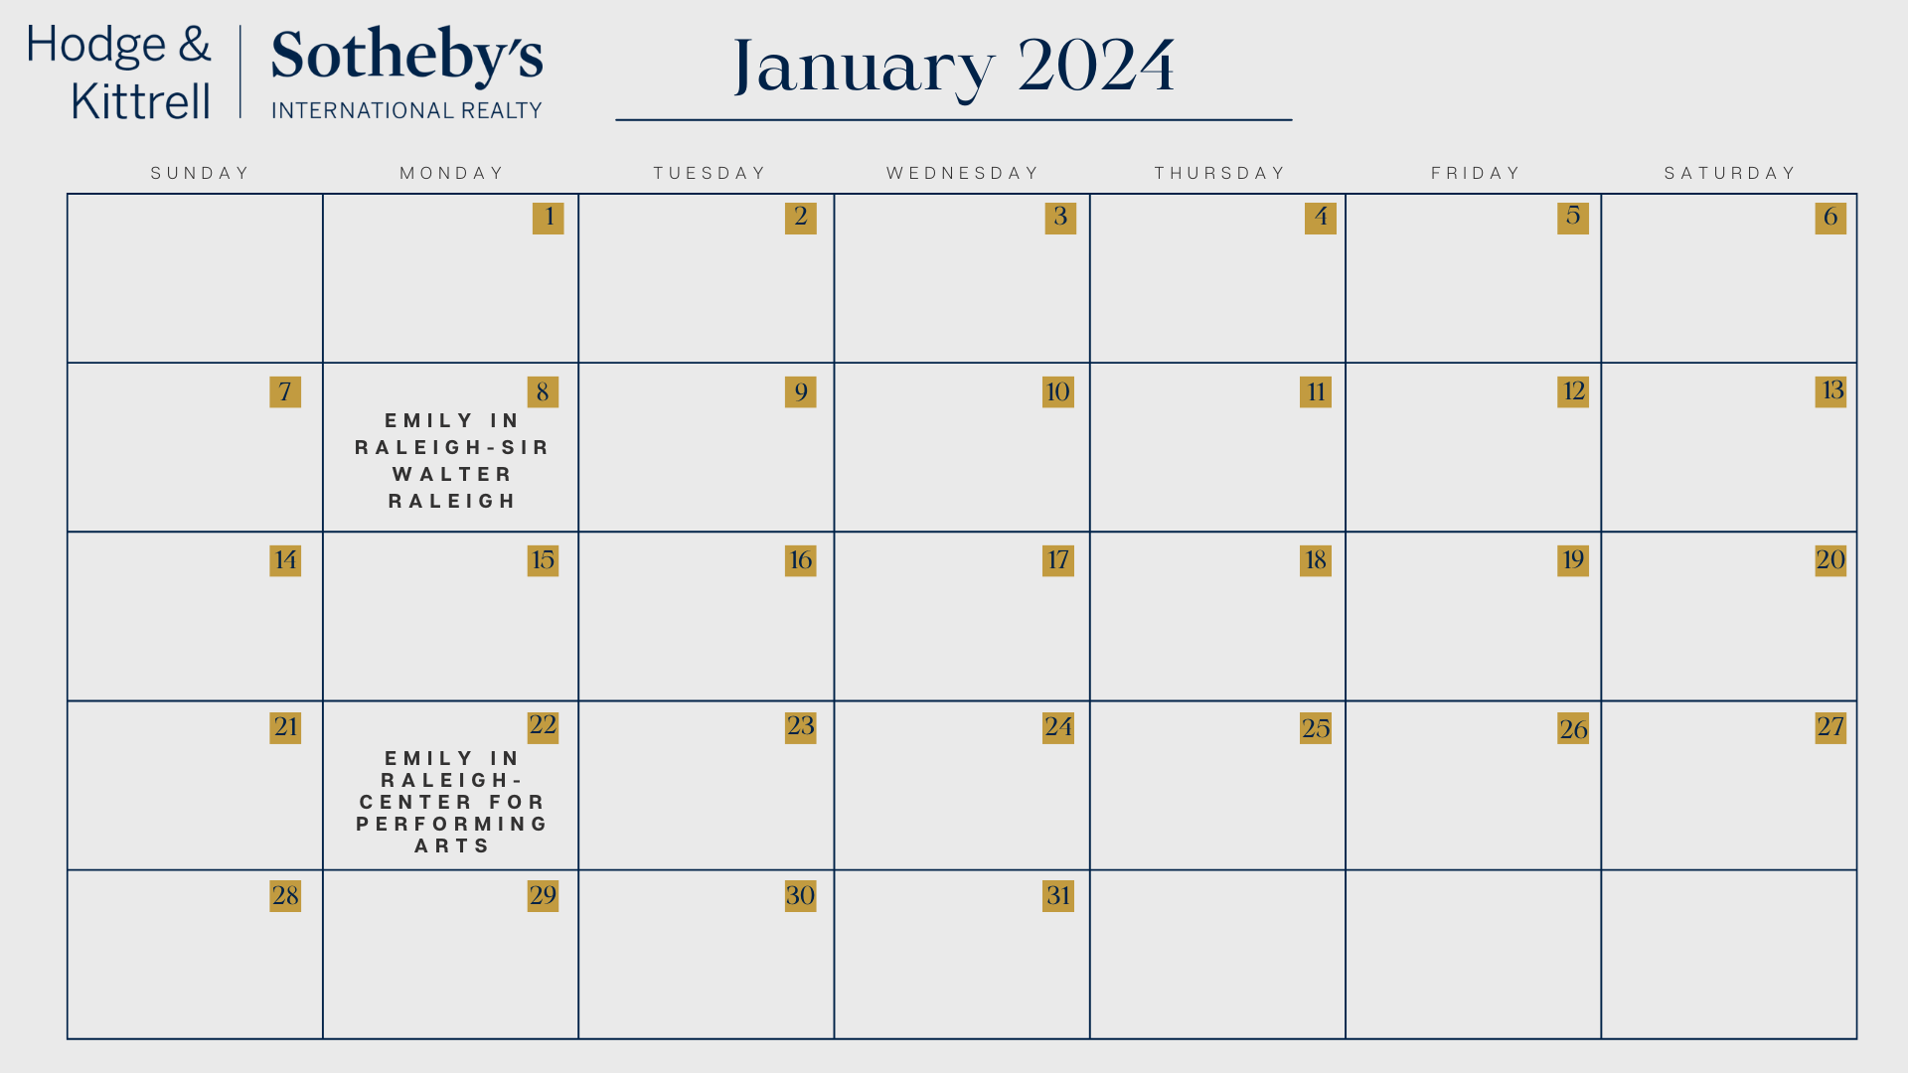
Emily in Raleigh Content Calendar
Notes:
Ayden
Post every other Monday starting January 8th. Every other Monday would just be the schedule for the Emily in Raleigh content, but we recommend Emily use this calendar for other content as well. The Martin Marietta center for performing arts previously known as DEPAC Duke Energy Performing Arts Center.

Slide 9
Measurable Results
Increase in average Instagram likes from current average of 19.2 likes (ranging from February 2020 to November 2023) to an average of 100 likes on posts starting from the beginning of the campaign.
Increase in Millennial and Gen-Z followers by 30 % from the beginning of campaign to the end.
Increase in website traffic as Millennials and Gen-Z become more aware of Hodge & Kittrell Sotheby’s.
Notes:
Taylor
(Survey proves it is not as well known by these publics)

Slide 10
Next Steps
What’s next? What do you recommend the client do in the near - to - mid-term to capitalize on your work?
  We recommend that Emily follow the content calendar that we created for her to ensure that she is consistent with her social media posts.
  Find a new hire to take care of marketing and communication materials.
Notes:
Ayden

Slide 11
Project Evaluation - “Big Ideas”
SHORT-TERM OPPORTUNITIES
  Maintain status and visibility in the community by attending upcoming events like celebrating Raleigh’s greatest holiday traditions (tree lightings, festivals, and parades).
  Continue to target Baby Boomers and Gen X audiences for a quicker turnover because they have cash and equity in their existing homes, whereas younger age groups are reluctant to tackle the current interest rates.
Notes:
Hailey

Slide 12
Project Evaluation - “Big Ideas”
MID-TERM OPPORTUNITIES
  Use door direct mail, neighborhood mailings, and new mover-marketing postcards to attract new prospects and the attention of both homeowners and buyers.
  Consistently post her ‘Emily in Raleigh’ photos from notable Raleigh landmarks to social media accompanied with our team’s strategic captions from January - July 2024 to drive enthusiasm for the campaign and expand from email only.
Notes:
Hailey

Slide 13
Project Evaluation - “Big Ideas”
LONG-TERM OPPORTUNITIES
  Attend functions where her desired audience will be such as wine bars, cocktail happy hours, animal-rescue events, holiday-themed events, and open houses for new businesses.
  Do partnerships! Sponsor local nonprofits or charity events races to increase publicity among younger audiences.
  Further develop her ‘Emily in Raleigh’ campaign by exploring over 40 free attractions offering art, culture, and entertainment.
  Hire an intern or assistant to manage marketing and communications
Notes:
Hailey
Partnerships → including walk-run-bike races

Slide 14
THANK YOU!
Notes:
Natalie
• Provide an overview of your plan: include a synopsis of your problem/opportunity, consider including a truncated SWOT analysis.
• Spend time focusing on what you set out to do in your plan.
• What is your objective?
• What are your key strategies and tactics?
• SHOW your work — screenshots, templates, etc.
• What’s next? What do you recommend the client do in the near - to - mid-term to capitalize on your work?
• Any “big ideas” you want to highlight? Are there things that you wish you had time or budget for that your client should consider going forward?

