Slide 1
Hodge & Kittrell Sotheby’s International Realty:
SWOT & Situational Analysis
Client: Emily Aldrich Barbour
Hailey Hawkins, Ayden Law, Meah Osborne, Taylor Randolph and Natalie Yeung
COM 476 FALL 2023

Slide 2
Client Background
Emily Aldrich Barbour:
  Real estate agent who works for Hodge & Kittrell Sotheby’s International Realty.
  Fun, carefree, approachable, and values class and style.
  Working in real estate for seven years.
  Been at Hodge & Kittrell Sotheby’s International Realty for seven years and is in the top 25 agents in the office.
  Graduated from NC State and for 12 years she has served on the Board of CHASS.
Hodge & Kittrell Sotheby’s International Realty:
  A subsidiary of the Sotheby’s International Realty.
  Hodge & Kittrell Sotheby’s International Realty was founded about 10 years ago.
  Locations in Chapel Hill, Raleigh and one coming soon to Apex.

Slide 3
Campaign Goals & Scope
GOALS
  Establishing herself as the go-to real estate agent in Raleigh
  Expanding into millennial and Gen Z client bases.
SCOPE
  Creating consistency in her online presence through branding
  Ideating about her social media strategy
  Conducting research on millennial and Gen Z needs.

Slide 4
SWOT Grid
Strengths: Part of an international parent company. Brand association. Great current housing market. We are not in an election year. Agents age and wisdom. Agents ability to relationship build. | Weaknesses: Limitations set by Sotheby’s International Realty brand. The brand appears geared towards the wealthy. Agent’s social media presence. Agent’s online presence. Limited client base (primarily 50-75 years old). Agent is behind on industry trends. Agent is lacking a personal team.
Opportunities: People and businesses moving into Raleigh. Tabling and booths at community events. Real estate awards. Posting on the Next Door app. Hiring a social media intern/assistant. Informational and educational social media content. | Threats: Political trends and administration in NC (Election Year influences homebuyer decisions) Top realtor competitors -niche players intensive field Clients are aging out of the home buying stage. Shifting population and buyer demographics. Market shifts in the Triangle (spiked interest rates). Lack of interest in new technology.

Slide 5
Situational Analysis: Problem Statement
Emily Barbour is seeing her current client base of 50-75 year old homebuyers age-out of needing her services as they are looking to downsize or move to senior living facilities. She needs to expand to millennial and Gen Z clients in the next five years to ensure she has stable and repeat business for the foreseeable future.

Slide 6
Situational Analysis: Client Mission
HKSIR
  We treasure the joy of uniting extraordinary homes with extraordinary lives
Emily
  Emily understands and delivers extraordinary customer service with a trained eye for quality home construction, design, and remodeling.

Slide 7
Situational Analysis: Existing Strategies & Act.
Social media content analysis form and results are here.
Agents at Sotheby’s International Realty must always represent the brand according to its branding guidelines.
  Currently, individual Sotheby’s International Realty offices develop relations with local media.
  Hodge & Kittrell SIR maintains an active presence on social media, as well as Sotheby’s International Realty.
  The national Sotheby’s International Realty handles most things related to public relations.
  SIR and HKSIR associates themselves with luxury. Think of Tiffany & Co.!

Slide 8
Situational Analysis: Research from Other Orgs.
“65% [of millennials] identified homeownership as a top sign of success. That number fell to 59% for Gen Zers — still a large figure, and neck-and-neck with that generation’s top choice of having a successful career (60%).”
(CNBC, 2022)
“[Millennials’] willingness to relocate may be because of remote and flexible work environments becoming more common … which could include discovering more affordable options, more space and a home in an area that meets that individual’s desired lifestyle.”
(Bankrate, 2022)
“Knowledge empowers buyers. So, in addition to his timeline chart… He also has an assistant and transaction coordinator who help to keep clients informed… “Fear is real. But fear is even scarier with the unknown, so we help them know what’s next.”’
(REALTOR® Magazine, 2022)
“One quarter of student loan debt holders say their debt has impacted their decision or their ability to purchase a home.”
(National Association of REALTORS®, 2021)
“...23% would purchase a home without seeing it in person first. That leap of faith is not as welcomed for the older generations, as only 16% of Gen X and 5% of baby boomers would consider buying a home without seeing it first. … More than half [of millennials], or 55%, either have or would be willing to buy an auction property.”
(Forbes, 2022)
“For this technology-inclined group, the capability to interact with their homes as they do with smartphones is an exciting prospect. There are many gadgets designed to set up a smart house and help overcome wearisome tasks. Automated security, heating and cooling, and lights are just a few modern technologies that simplify modern living.”
(The Plan Collection, 2022)

Slide 9
Situational Analysis: Stakeholders and Audience
Stakeholders
  Emily & her employees
  Company executives
Audience → Homebuyers:
  Boomers and Gen-X (probable)
  Millennials (possible)
  Gen-Z (unlikely)
Self Interest: gaining assistance from a professional and acquiring a new home
Opinion Leaders/Influentials: young homeowners and online influencers who showcase their homes
Current Relationship: good relationship with Boomers and Gen-X, little to no relationship with Millennials and Gen-Z
Considerations:
Costs
  majority of Gen-Z and Millennials cannot afford to buy homes in this housing economy
  purchasing a home can cause an excess of stress
  moving away from people their age
  hiring a real estate agent, listings fees
Rewards
  builds credit & equity, control over monthly payments
  comfort of privacy and freedom owning your own space
  Brings stability to neighborhoods, increases tax dollars for public schools

Slide 10
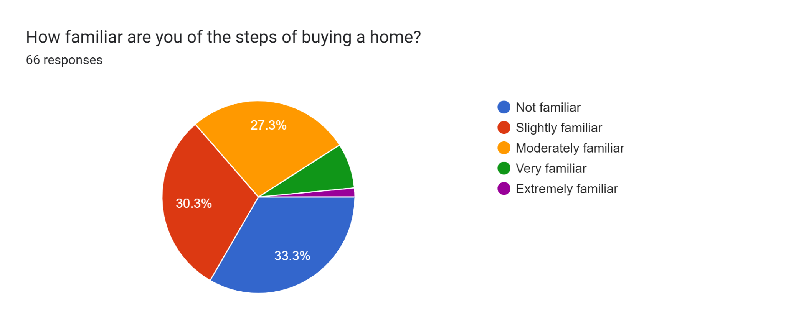
Situational Analysis: Primary Research
We are conducting a target audience survey through Google Forms.
  Target Audience: Gen-Z and Millennials
Asking about current housing situation, homebuying likelihood, understanding of homebuying, attitudes towards realtors

Slide 11
Situational Analysis: Issues Affecting the Problem
Interest Rates - Emily needs new clients but younger generations may not be able to afford it because of their reluctance to take on the new, high interest rates
  Avg home mortgage interest rate topped 7% in Aug 2023, highest in two decades!
  “A year ago, rates were just over 5%. That increase means someone borrowing $300,000 on a house can expect to pay $400 more every month,” (Horsley, 2023).
  Coldwell Banker: 35% of respondents are hesitant to purchase a home due to rising interest rates and 27%+ feared a potential recession. Concerns are stock market fluctuation, inflation and higher home prices (Pacaso, 2023).
Target Market - Generational Gap: does she have the tools to expand to this market?
  Emily must adapt her marketing approach by using effective technological strategies to secure retention, grow her business and appeal to younger generations.
  CBS News reported Baby Boomers overtake Millennials as the largest generation of homebuyers. NAR data from March 2023 reveals Boomers, ages 58-76, made up 39% of home buyers in 2022, compared to 28% for millennials. (Brooks, 2023).

Slide 12
Situational Analysis: Issues Affecting the Problem
Communication Channels - Word of mouth referrals: She needs to focus on revamping her avenues and expanding her network to go after the buyers she is looking for. Luxury real estate is a highly desirable and competitive market
  Smaller homes are becoming more popular for luxury homebuyers. In 2022, they sold 19% faster than larger ones. This suggests that affluent buyers are downsizing, and it might become the new normal with increasing home prices (Pacaso, 2023).
Attracting Digital Natives Through Mobile-Friendly Websites - Does she have the tools to expand to this market? Changing Digital Landscape
  Online buy/sell reduced realtor relationships thus reducing the agent commission
  For millennials, she must compete with newer and more innovative third parties, including apps and websites without the high-end real estate commissions.
  NAR, “95% of homebuyers of all ages used the internet during their home search, and 1/2+ found the property they would eventually purchase” (CoreLogic, 2022).

Slide 13
Issues Affecting the Problem: Causes & Reasons
Interest Rates - Emily needs new clients (problem), but the younger generations who are in her target market for larger, luxury houses and family homes may not be able to afford it because of their reluctance to take on the new, high interest rates (issue).
The average home mortgage interest rate topped 7% in August 2023, making it the highest it’s been in more than two decades! “A year ago, rates were just over 5%. That increase means someone borrowing $300,000 on a house can expect to pay about $400 more every month,” (Horsley, 2023).
According to a Coldwell Banker survey, 35% of its respondents appeared to be hesitant to purchase a home due to the rising interest rates and over 27% feared that a potential recession would halt their luxury home purchase decision. The areas of greatest concern for homebuyers in 2023 are stock market fluctuation, inflation, and higher home prices (Pacaso, 2023).
Target Market - Emily needs to address the generational gap in her customer base (problem), but does she have the tools to expand to this market (issue)? Emily must adapt her marketing approach by using effective technological strategies including social media platforms to secure retention but more importantly, grow her business and appeal to younger generations. To best understand this, we need to consider the average age of a luxury homebuyer.
CBS News reported that Baby Boomers overtake Millennials as the largest generation of homebuyers. NAR data from March 2023 reveals that Boomers, ages 58-76, made up 39% of home buyers in 2022, compared to 28% for millennials. This is a 29% increase from last year, making it the highest percentage of any generation (Brooks, 2023).

Slide 14
Issues Affecting the Problem Continued…
Communication Channels - Emily relies on word-of-mouth referrals (problem) which works, but her likely referral base is going to be similarly situated and not in the position to buy a new house (issue). She needs to focus on revamping her avenues and expanding her network to go after the buyers that she is looking for. Since luxury real estate is a highly desirable and competitive market, we must first look at who is in the market for luxury homes?
Smaller homes are becoming more popular among luxury homebuyers and cheaper. In 2022, they sold 19% faster than larger ones. This research suggests that affluent buyers may not need the extra square footage due to their busy lifestyles which means that downsizing might become the new normal with increasing home prices (Pacaso, 2023).
Attracting Digital Natives Through Mobile-Friendly Websites - People are using technology where you buy/sell and are no longer building a relationship with a realtor thus reducing the agent commission (problem), in order to sell to millennials, Emily must compete with newer and more innovative methods of real estate from third parties (issue). Apps and websites such as realtor.com, help-u-sell.com, and other flat fee real estate sellers promote how to find what you’re looking for without having to pay the high-end real estate commissions. Clearly, the digital landscape is rapidly changing things which could create potential consequences for Emily. Let’s examine what percentage of homebuyers are using new technology.
According to the NAR, “95% of homebuyers of all age groups used the internet during their home search, and just over half found the property they would eventually purchase online” (CoreLogic, 2022).

